Slide 1
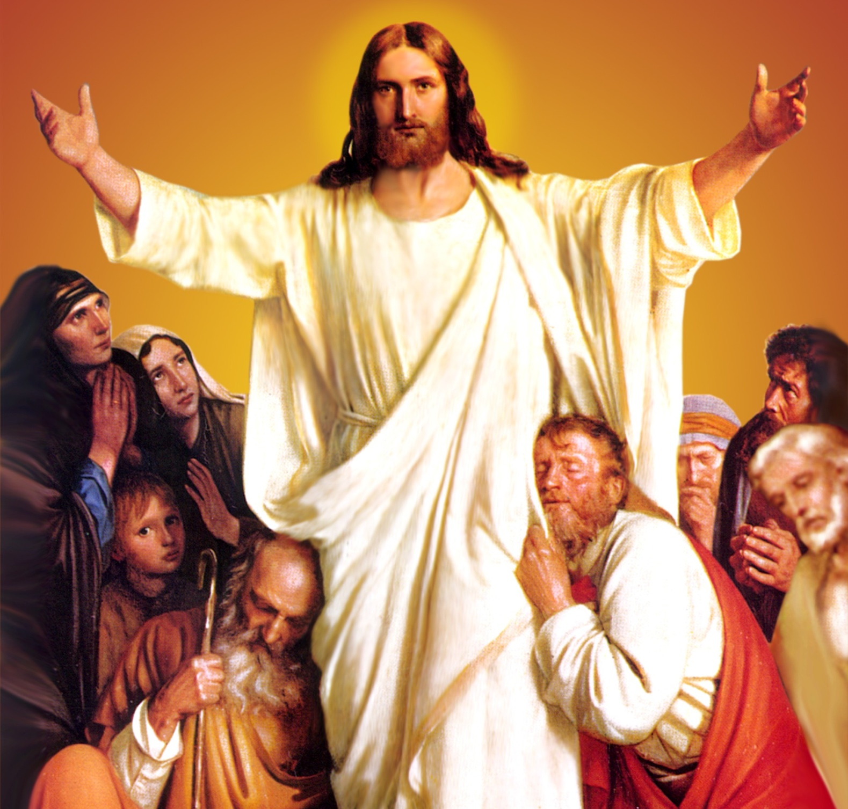
CATECHETICAL TEXTBOOK SERIES OF THE SYRO - MALABAR CHURCH
ON THE PATH OF SALVATION - 6
PEOPLE WHO
EXPERIENCED JESUS
6

Slide 2
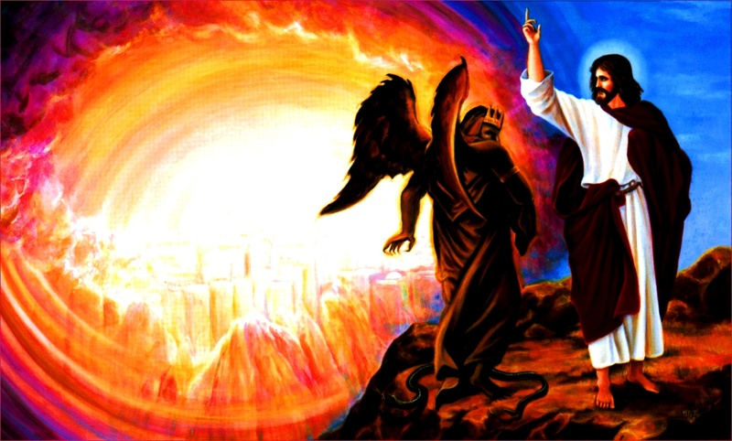
LESSON 3
JESUS WHO OVERCAME TEMPTATIONS

Slide 3
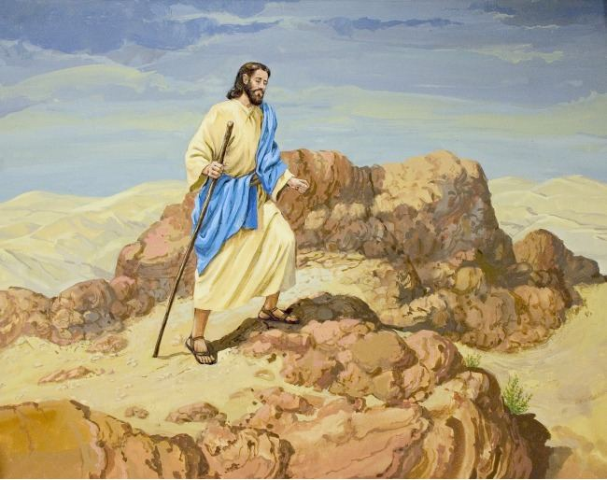
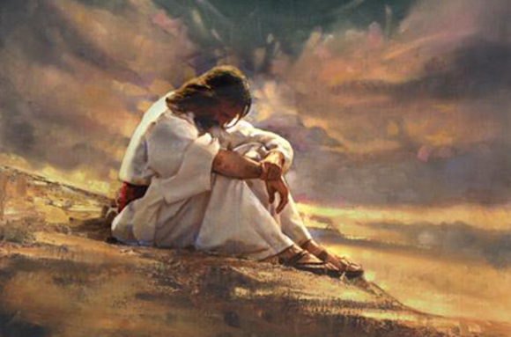
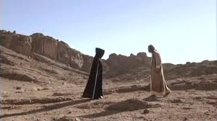
IN PREPARATION FOR THE START OF HIS PUBLIC LIFE JESUS FASTED AND PRAYED FOR FOURTY DAYS. THIS MADE HIM VERY HUNGRY.
THE TEMPTER CAME

Slide 4
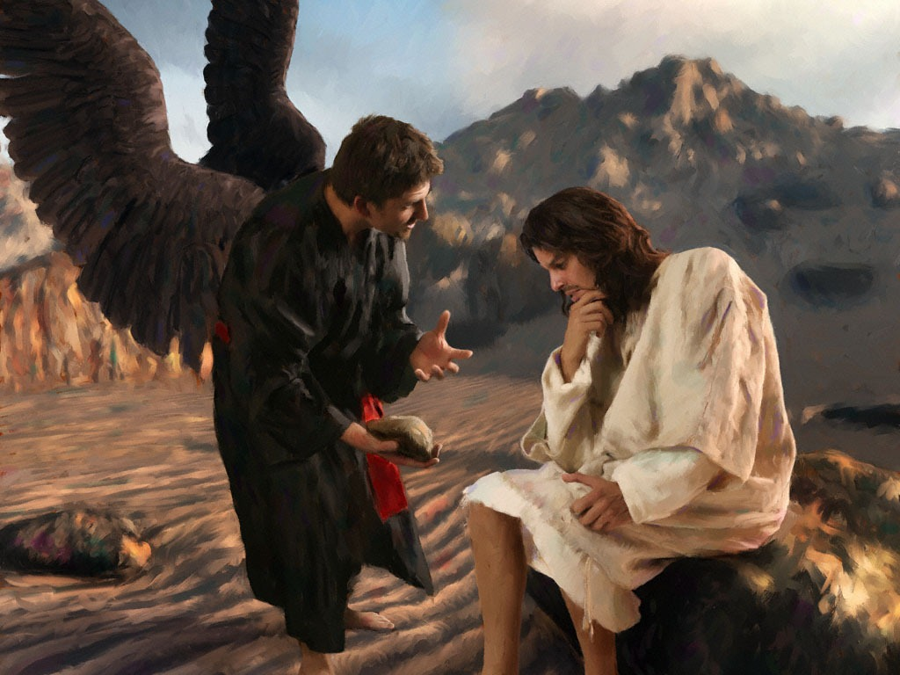
If you are the son of man command these stones to turn into loaves of bread”.

Slide 5
It is written; “Man does not live by bread alone But by every word that comes out of the mouth of God.

Slide 6
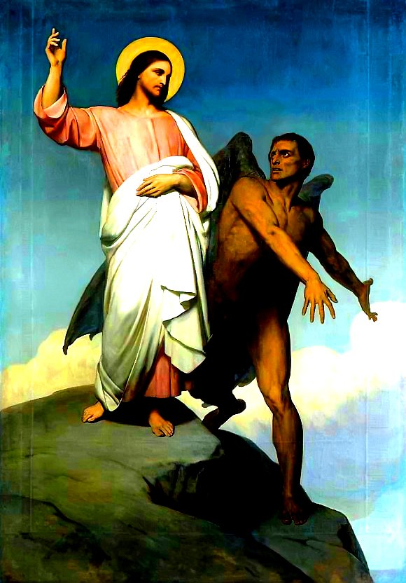
“ If you are the Son of God, throw yourself down; for it is written, “ He will command his angels concerning you, And on their hands they will bear you up, So that you will not dash your foot against a stone.”

Slide 7
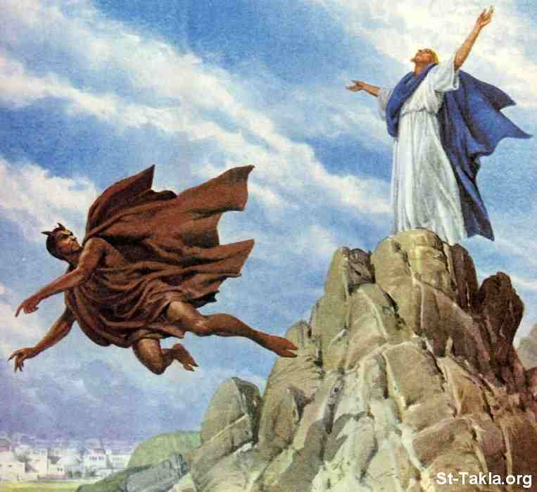
Defeated the tempter again using another word of God.
“ It is also written that you shall not tempt the Lord your God.”

Slide 8
“ Away with you Satan! For it is written, `Worship the Lord your God and serve only him.”
The devil took him to a very high mountain and showed him all the kingdoms of the world and their splendor.
All these I will give you if you fall down and worship me.”

Slide 9
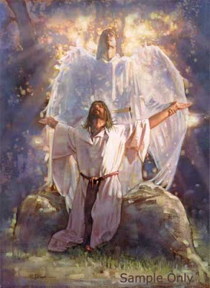
The Devil left him, and suddenly angels came and waited on him. Jesus was tempted to misuse his divine powers for ……
Luxury
Power
wealth

Slide 10
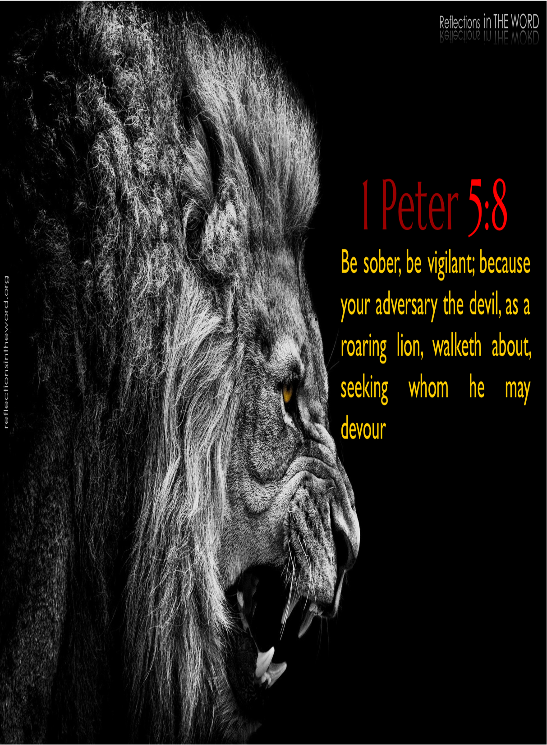
Jesus was able to defeat Satan, the tempter, because he had developed spiritual strength through abstinence, fasting and prayer.
Satan who tempted even Jesus the Son of God, approaches us in various ways to tempt us.

Slide 11
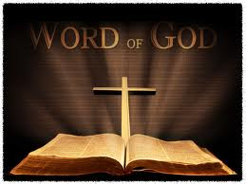
WORD OF GOD BASED LIFE
Gives us power to overcome temptations.
Keeps us away from the ways of sin.
It sanctifies us.

Slide 12
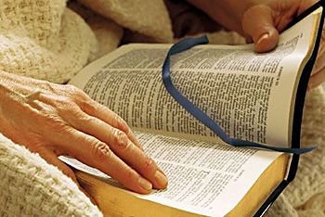
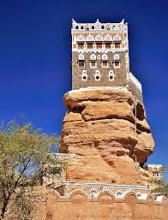
One who reads the word of God, meditates on it and lives accordingly is like the wise person who constructed
his house on a rock. A life with strong foundations on the word of God strengthens us to advance without faltering, in the face of all adversities.

Slide 13
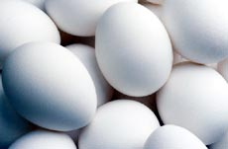
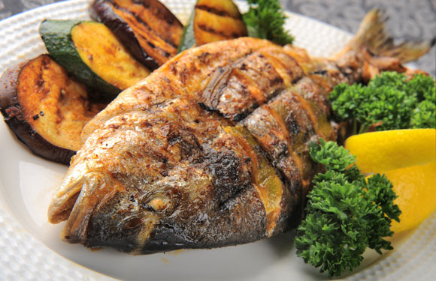
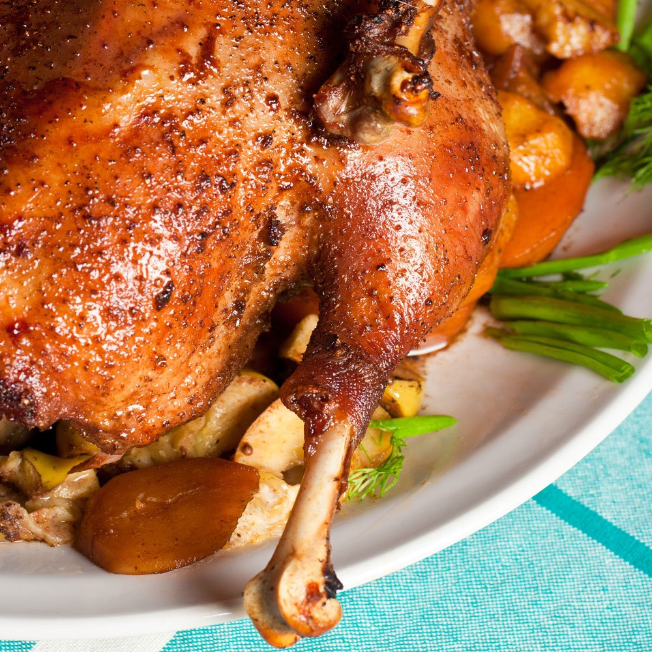
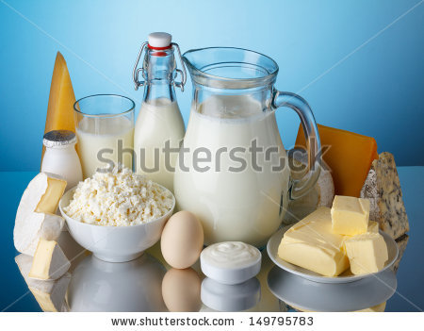
FASTING AND ABSTINENCE
Fasting, abstinence and prayer give us strength to overcome temptations.
Mar Thomas Christians (Nazranees) as `friends of abstinence’
During these days of abstinence they used to avoid food items such as meat, fish, egg, milk and milk products.

Slide 14
THERE WERE SEVERAL SUCH SEASONS OF ABSTINENCE (NOMBU) These include.
50 DAYS - PREPARATION FOR EASTER
(AMBATHU NOMBU)
25 DAYS - PREPARTION FOR X-MAS
(IRUPATHANCHU NOMBU)
15 DAYS - FOR THE FEAST OF ASSUMPTION OF OUR LADY (PATHINACHU NOMBU)
08 DAYS - FOR THE BIRTH DAY OF OUR LADY
(ETTU NOMBU)
03 DAYS - THAT COME BEFORE THE START OF LENT (MOONNU NOMBU)

Slide 15
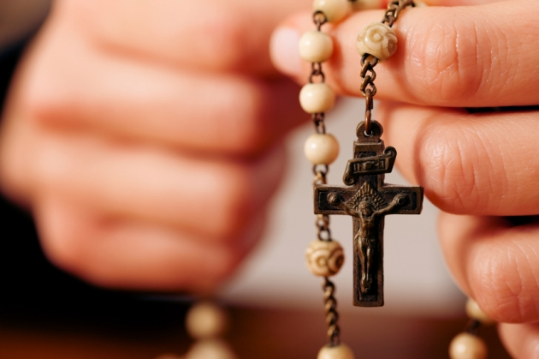
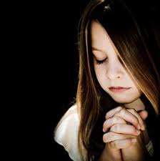
The meaning of the Malayalam word, upvaasam is `to live together’
Spend the whole day with God in prayer.

Slide 16
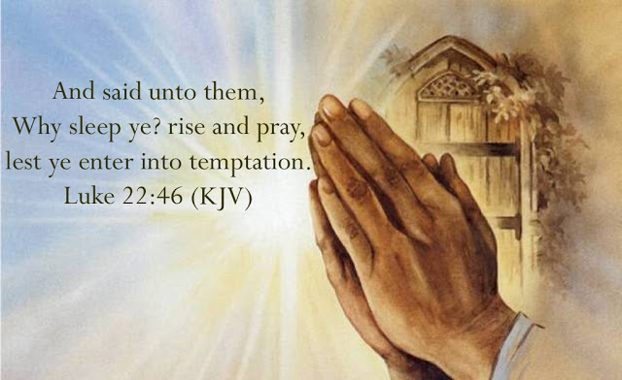
PRAYER
PRAYER IS CONVERSATION WITH GOD.
PRAYER IS IMPORTANT IN OUR LIFE TO OVERCOME TEMPTATIONS.

Slide 17
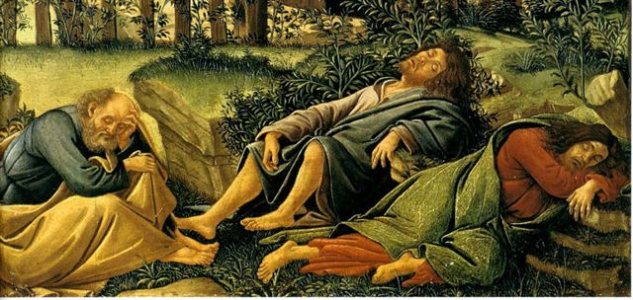
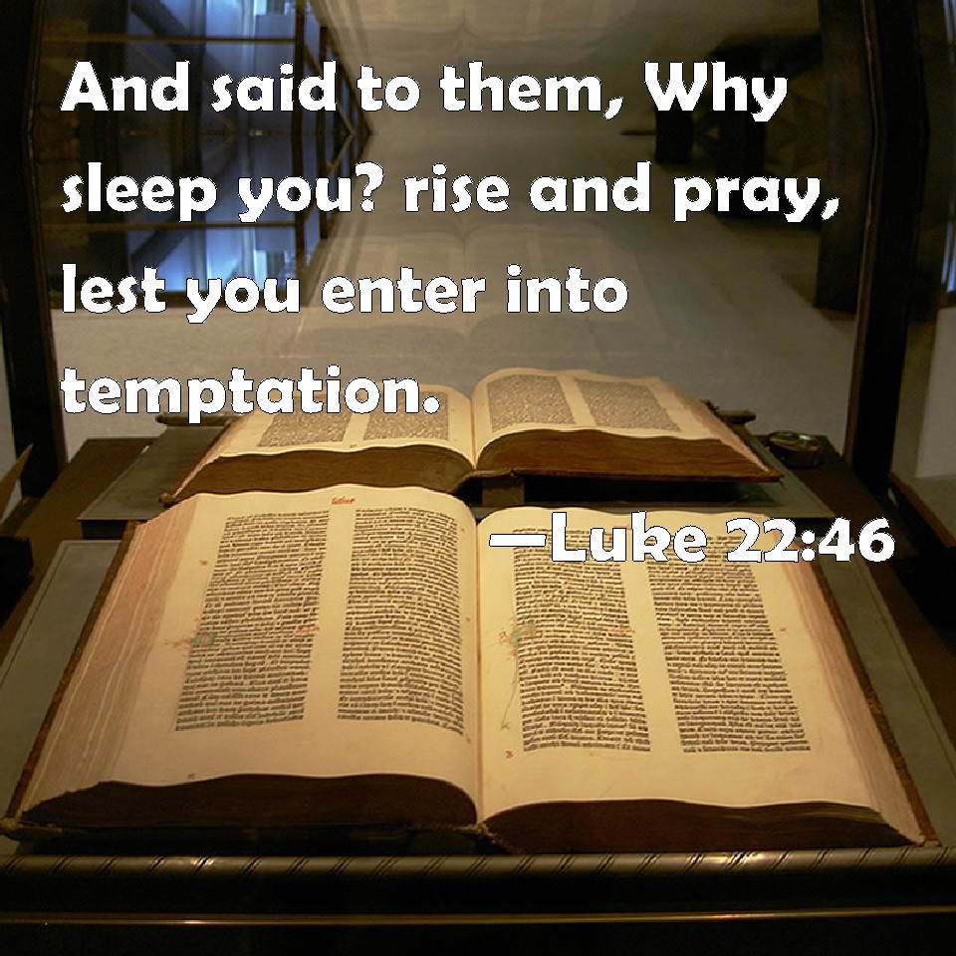
IN THE GARDEN OF GETHSEMANE, JESUS TOLD HIS DISCIPLES WHO COULD NOT KEEP AWAKE WITH HIM:

Slide 18
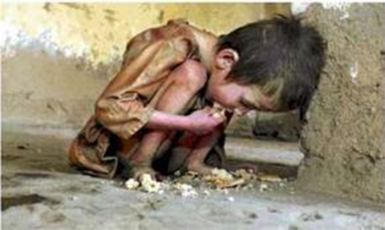
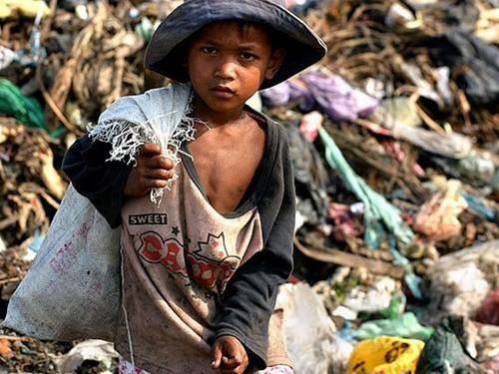
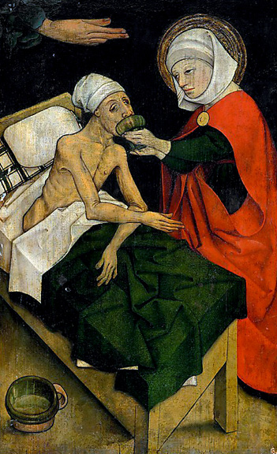
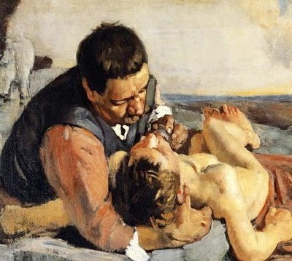
ACTS OF MERCY Abstinence, fasting and prayer
CHILDREN CAN DO THINGS LIKE VISITING THE SICK AND PRAYING FOR THEM HELPING THE POOR THROUGH MONEY RAISED BY SIMPLE ACTS OF SERVICE AND ENCOURAGING PARENTS IN CHARITABLE DEEDS LIKE AIMSGIVING.

Slide 19
SEASON OF LENT
Fourth Season .
We commemorate the time Jesus spent in the wilderness in fasting and prayer for preparation for his public life.

Slide 20
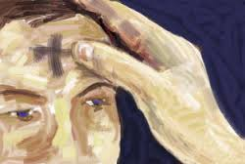
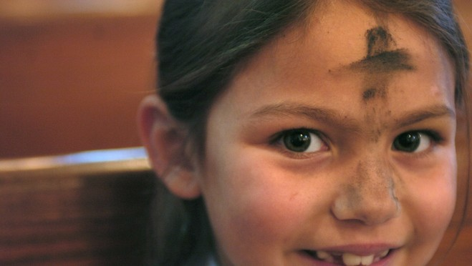
We meditate the passion of our Lord and to pray.
This is known as Valiyanombu in Malayalam
The first Sunday of lent, seven weeks before Easter is called Pethurtha.
At the start of lent we celebrate the repentance service where the priest applies ash on our foreheads.
The lenten season invites us to recollect our sins and repent over these, and by doing penance for these, to start a new life in Jesus.

Slide 21
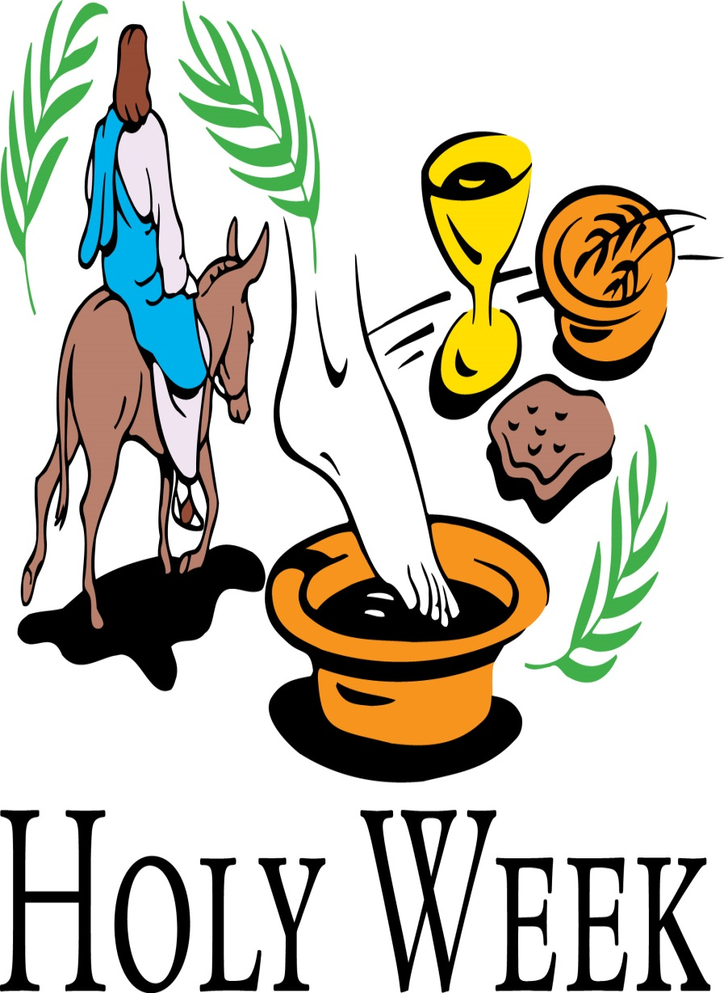
HOLY WEEK

Slide 22
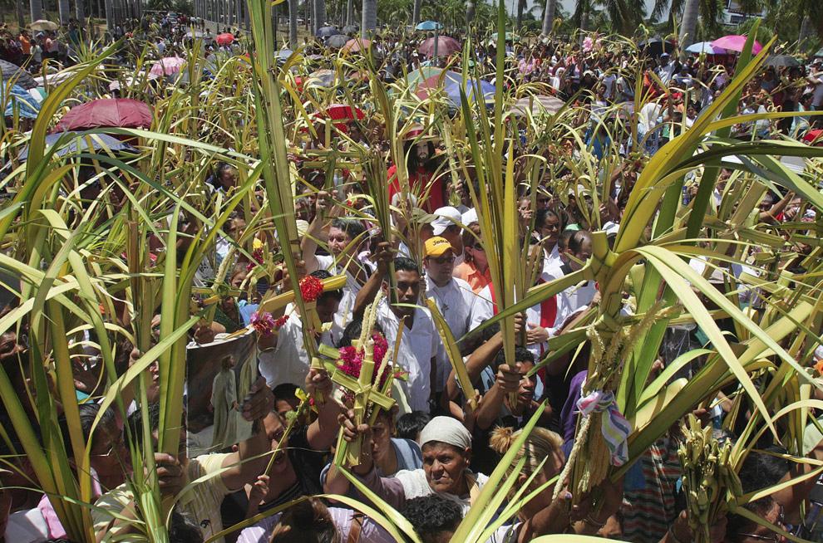
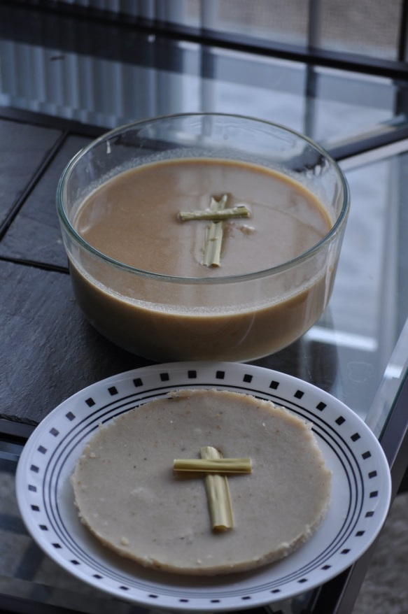
The last week of lent as Holy Week.
Starting with Palm Sunday.
We remember the Institution of Holy Eucharist and the Priesthood On Maundy Thursday. That evening in our homes we observe the service of Sacred bread.

Slide 23
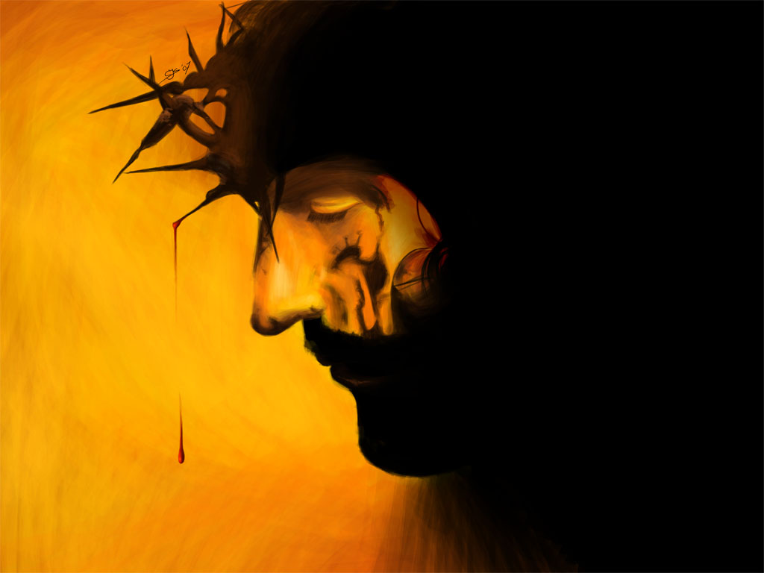
We recollect and remember
On Good Friday - passion, crucifixion and death of Jesus.
On Holy Saturday - Sorrows of Our Lady
On Sunday - Resurrection of Jesus.

Slide 24
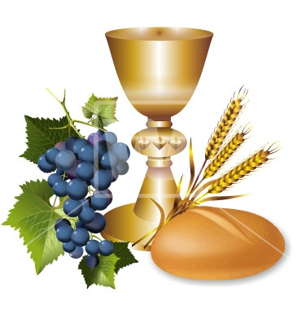
As we pray in the Holy Mass, let us please God, the Father, Son and the Holy Spirit, by fasting, prayer and repentance. This lead us holy lives, overcoming temptation and gaining spiritual strength by living in accordance with Holy Word of God, a life of abstinence, fasting and prayer.

Slide 25
Let us pray
O! Jesus, you, who were led to the wilderness by the
Holy Sprint and fasted for forty days and nights, help us to be filled with the Spirit of fasting and penance.

Slide 26
Read the word of god:
Mathew 4: 1-11

Slide 27
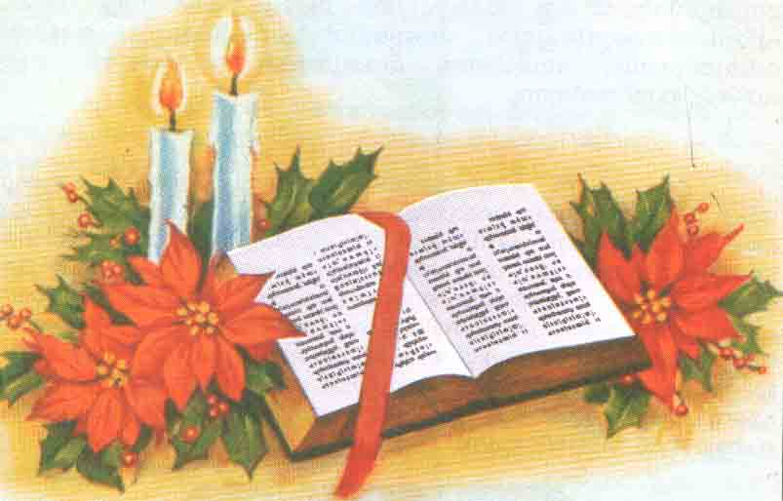
WORD OF GOD FOR GUIDANCE
"One does not live by bread alone but by every
word that comes from the mouth of God" (Mt.4:4).

Slide 28
LET US DO:
Write down some of the acts of penance that
you can do during the season of lent.
……………………………………………………………………………………………………
……………………………………………………………………………………………………
……………………………………………………………………………………………………

Slide 29
MY DECISION
I will abstain from meat during
the season of lent.

Slide 30
LET US Find out the answer
1. With which word of God did Jesus overcome the temptation of the devil who prompted him to make bread out of stones to satisfy his hunger?
2. How could Jesus defeat Satan who tempted him?
3. What are abstinences that are prevalent in the Syro-Malabar Church?
4. What is the message that the season of lent gives us?
5. From which day does the season of lent begin?

Slide 31
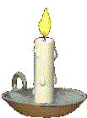
Thank you

